Slide 1
Designing Effective Output
11
Systems Analysis and Design, 8e
Kendall & Kendall

Slide 2
Output
Information delivered to users
Output forms
Hard-copy—printed reports
Soft-copy—computer screens, microforms, and audio
To create output, the analyst works interactively with the user until the output is satisfactory.
Notes:
Output can be delivered via:
intranets
Extranets
WWW

Slide 3
Relating Output Content to Method
Content of output must be considered as interrelated to the output method.
External—going outside the business
Internal—staying within the business
Notes:
Internal output is used within the corporation.
External output is used outside the organization.

Slide 4
External Output
Examples:
Utility bills
Advertisements
Paychecks
Differs from internal output in:
Distribution
Design
Appearance
Notes:
Many external documents must include instructions to the recipient if they are to be used correctly.

Slide 5
Internal Output
Examples:
Summary reports
Detailed reports
Historical reports
Exception reports
Might consist of material available on an intranet

Slide 6
Output Technologies
Printers
Display screen
Video, audio, and podcasts
DVD and CD-ROM
Electronic output
Notes:
Producing different types of output requires different technologies.

Slide 7
Printers
The trend in printers is toward increased flexibility.
Key factors of printers:
Reliability
Compatibility with software and hardware
Manufacturing support
Notes:
Trends:
location of the printing site
different numbers of characters per page
more graphics and color capabilities
quieter
reducing the number of preprinted forms
simplifying operator tasks
reducing operator intervention

Slide 8
Display Screen
Advantages:
Result in cost savings
May be desirable from the user’s standpoint
Easier to keep up to date
Disadvantages:
Different screen resolutions
Fonts
Notes:
Result in cost savings – no paper, mailing.
May be desirable from the users standpoint – may want to just glance at a report and then file.
Easier to keep up to date – displays can update output immediately.
Different screen resolutions – 800x600 or 1600x1200 and so on.
Fonts – some systems may not have the fonts required. One way this has been addressed is to send documents as PDF files.

Slide 9
Video, Audio, and Animation
Video
Combines the impact of audio with a visual channel
Audio
Transient, usually output for the benefit of one user
Animation
The presentation of different images in a series, one at a time

Slide 10
CD-ROMs and DVDs
Less vulnerable to damage from human handling
Can include full-color text and graphics as well as audio and video
Notes:
Can also be used for backup storage

Slide 11
Electronic Output
Email
Faxes
Bulletin board messages

Slide 12
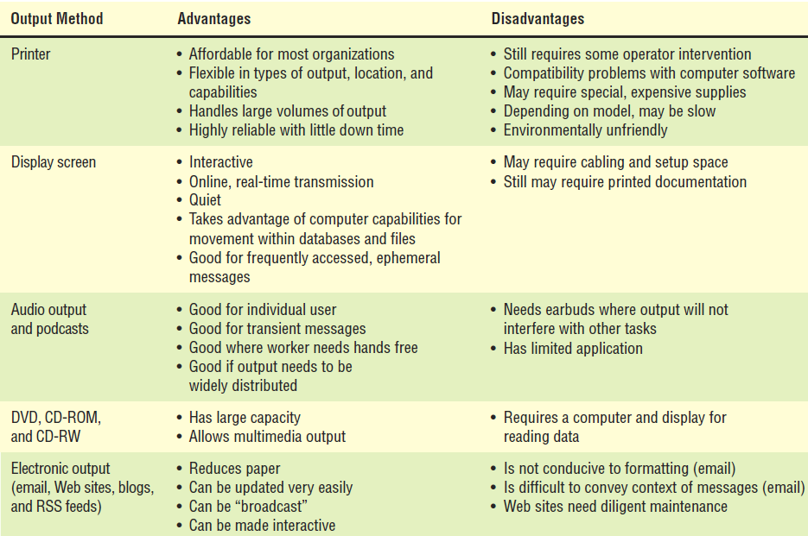
A Comparison of Output Methods

Slide 13
Factors to Consider When Choosing Output Technology
Who will use the output?
How many people need the output?
Where is the output needed?
What is the purpose?
What is the speed with which output is needed?
How frequently will the output be accessed?
How long will the output be stored?
Regulations depicting output produced, stored, and distributed
Initial and ongoing costs of maintenance and supplies
Human and environmental requirements
Notes:
Although the technology changes rapidly, certain usage factors remain fairly constant in relation to technological breakthroughs.
Who will use the output – job requirements help dictate what output is appropriate.
How many people need the output – if many people need output, Web-based with a print option or printed copies.
if only one use, a screen or audio.
if many people, different outputs, different times for short periods and need it quickly then Web documents or screens connected to terminals.
Where is the output needed – physical destination of the output.
What is the purpose – what user and organizational tasks are supported.
What is the speed with which output is needed – the higher the level of management the faster the output is desired.
How frequently will the output be accessed – infrequently accesses output that is needed by only a few users is well suited to a CD-ROM archive.
How long will the output be stored – paper deteriorates with age. Microforms or digitized is better.
Regulations depicting output produced, stored, and distributed – the appropriate format for some output is regulated by the government.
Initial and ongoing costs of maintenance and supplies – initial cost and ongoing cost must be considered.
Human and environmental requirements – Accessibility, absorption, controlled temperature, space for equipment, cabling, proximity to Wi-Fi transmitters or access points.

Slide 14
Output Bias
Analysts must avoid unnecessarily biasing output and make users aware of the possible biases in output.
Bias is introduced in three main ways:
How information is sorted
Setting of acceptable limits
Choice of graphics
Notes:
Bias is present in everything that humans create.
How information is sorted – Bias is introduced to output when the analyst and users make choices about how information is sorted for a report; alphabetical, chronological, cost.
Setting of acceptable limits – the predefinition of limits for particular values being reported.
Choice of graphics – bias can occur in the selection of the graph size, its color, the scale used, and even the type of graph.

Slide 15
Designing Printed Output
Detailed reports
Print a report line for every record on the master file.
Exception reports
Print a line for all records that match a certain condition.
Summary reports
Print one line for a group of records that are used to make decisions.

Slide 16
Report Design Conventions
Constant information remains the same whenever the report is printed.
Variable information can vary each time the report is printed.
Paper quality, type, and size
Notes:
Conventions to follow when designing a form include the type of data that will appear in each position, showing the size of the form being prepared, and showing the way to indicate a continuation of data on consecutive layout forms.
Constant information – title of the report and all of the column headings
Paper quality, type, and size – the overriding constraint is cost.

Slide 17
Designing Output for Displays
Keep the display simple.
Keep the presentation consistent.
Facilitate user movement among displayed output.
Create an attractive and pleasing display.
Notes:
Differences between printed and display:
display is ephemeral
display can be more specifically targeted to the user
display is available on a more flexible schedule
display is not portable in the same way as printed
display can sometimes be changed through direct interaction
with display users need to be instructed on use
access to displays may be controlled through a password

Slide 18
Graphical Output in Screen Design
The purpose of the graph
The kind of data to be displayed
The audience: The effects on the audience of different kinds of graphical output
Notes:
Output must be accurate, easy to understand and use.
In the instance of a decision support system, the purposes of graphical displays are to support any of the three phases of problem solving or user experiences: intelligence, design, or choice.

Slide 19
Dashboards
Make sure the data has context.
Display the proper amount of summarization and precision.
Choose appropriate performance measures for display.
Present data fairly.
Choose the correct style of graph or chart for display.
Use well-designed display media.
Limit the variety of item types.
Highlight important data.
Arrange the data in meaningful groups.
Keep the screen uncluttered.
Keep the entire dashboard on a single screen.
Allow flexibility.

Slide 20
Widgets and Gadgets
Can be any type of a program that may be useful to any person interacting with a computer
Can empower users to take part in design of their own desktop
Notes:
Widgets and Gadgets – clocks, calculators, bookmark helpers, translators, search engines, easy access to utilities, quick launch panels, sticky notes
Designers can learn what users prefer when they study user-designed desktops.

Slide 21
Designing a Web Site
Use professional tools.
Study other sites.
Use Web resources.
Examine the sites of professional Web site designers.
Examine poorly designed Web sites.
Notes:
Use professional tools – Web editors such as Macromedia Dreamweaver.
Studying other sites – Firefox is a great browser for studying other Web sites.
Use Web resources – look at Web sites that give hints on design. i.e. useit.com
Examine the sites of professional Web site designers – often visited and praised Web sites.
Use the tools you’ve learned – use a form to evaluate Web pages systematically.
Consult the books – read about Web design.
Examine poorly designed Web pages – critique poor web pages and remember to avoid those mistakes.

Slide 22
Designing a Web Site (Continued)
Creating Web templates
Style sheets allow you to format all Web pages in a site consistently.
Using plug-ins, audio, and video
Notes:
Creating Web templates – if you adopt a standard-looking page for most of the pages you create, you’ll get the Web site up and running quickly and it will consistently look good.
Using plug-ins, audio, and video sparingly – remember that everyone does not have new plug-ins.

Slide 23
Designing a Web Site (Continued)
Plan ahead, pay attention to:
Structure
Content
Text
Graphics
Presentations style
Navigation
Promotion
Notes:
Plan ahead – good Web sites are well thought out.

Slide 24
Structure
One of the most important steps in developing a professional Web site
Each page in the Web structure should have a distinct message.
Can benefit from using Web site diagramming and mapping tools
Notes:
Think about your goals and objectives.
Diagramming and mapping tools become even more important when maintaining a Web site.

Slide 25
Content
Appropriate content is needed to keep the user interested
Use a metaphor or images that provide metaphor for your site
Should include a FAQ page
May take advantage of prewritten software
Notes:
If a user stays at your site for a long period of time, your site has a high degree of stickiness.
Avoid the overuse of cartoons and don’t be repetitive.
FAQ are created based on the experiences of users and technical support people who identify the topics of continuing concern.
Prewritten software may include search engines, mapping software, weather information, and news and stock tickers.

Slide 26
Text
Each Web page should have a title.
Place meaningful words in the first sentence appearing on your Web page.
Clear writing is important.
Notes:
Don’t forget that text is important.

Slide 27
Graphics
Use either JPEG or GIF formats.
Keep the background simple and readable.
Create a few professional-looking graphics for use on your pages.
Keep images small and reuse bullet or navigational buttons.
Examine your Web site on a variety of displays and screen resolutions.
Notes:
JPEG’s are best for photographs, and GIFS are best for artwork.
When using a background pattern, make sure that you can see the text clearly on top of it.
Once an image has been received, it will be taken from the cache when ever it is used again.
The text displays when the user moves the mouse over the image and is essential to support Web accessibility impaired site visitors.
Scenes and text that look good on a high-end video display may not look good to others with poorer-quality equipment.

Slide 28
Presentation Style
Provide a home page.
Keep the number of graphics to a reasonable minimum.
Use large and colorful fonts for headings.
Use interesting images and buttons for links.
Use CSS (a style sheet language) to control the formatting and layout of the Web page.
Notes:
Provide a home page – should be 100 kilobytes or less and load in less then 14 seconds. Should be much like a menu.
Keep the number of graphics to a reasonable minimum – it takes additional download time to transfer a graphics-intensive site.
A group of images combined into a single image is called an image map, which contains various hot spots that act as links to other pages.
Cascading style sheets (CSS) control the formatting of the Web pages. A change to the style sheet will change all the Web pages using it.

Slide 29
Presentation Style (Continued)
Use divisions and cascading styles or tables to enhance a layout.
Use the same graphics image on several Web pages.
Use Javascript to enhance Web page layout.
Avoid overusing animation, sound, and other elements.
Notes:
Tables are easy to use and provide adequate layout. Tables are not well suited for visually impaired.
Divisions eliminate the need for tables within tables and simplify design helps make the site accessible for visually impaired.
Use the same graphics image on several Web pages – consistency will be improved, and pages will load more quickly.
Use Javascript to enhance Web page layout – have images that change when a mouse moves over them or having menus expand and so on.

Slide 30
Navigation
The three-clicks rule
Promote the Web site
Notes:
The three-clicks rule – a user should be able to move from the page they are currently on to the page containing the information they want in three clicks of the mouse button.

Slide 31
Promotion
Promote your site.
Submit often to search engines.
Include key words in metatags.
Encourage your readers to bookmark your Web site.
Notes:
Promote your site – don’t assume that users will find your Web site.
Submit often to search engines – don’t assume that search engines will automatically find your Web site.
Include key words in metatags – search engines use metatags to link search requests to your site.
Encourage your readers to bookmark your Web site – users will be encouraged to revisit if they bookmark your site.

Slide 32
Maintaining Web Sites
Ecommerce sites require frequent updating.
Content management systems (CMS)
Software tools
Enable the analyst to develop and maintain Web sites

Slide 33
Output Production and XML
An XML document may be transformed into different output media types.
Methods:
Extensible Style Language Transformations (XSLT)
Ajax
Cascading style sheets (CSS)
Notes:
These methods reinforce the idea that data should be defined once and used many times in different formats.

Slide 34
Extensible Style Language Transformation (XSLT) Software Can Be Used to Transform XML Documents into Many Different Formats for a Variety of Platforms (Figure 11.17)

Slide 35
Ajax
Uses both JavaScript and XML to obtain small amounts of data from a server without leaving the Web page
The user does not have to wait for a new Web page to display after making a selection.
Notes:
Using Ajax means that the entire Web page does not have to be reloaded.
Since Ajax covers both input and output it is also covered in chapter 12.

